Slide 1
Solar Cell Dataset

Slide 2


About Me
Background in Materials Science, Machine Learning, and Software Engineering
Senior Software Engineer & Lead Applied AI @ Swift Solar
From fundamental research at UW to applied ML at Swift Solar & Twelve
ML/AI Applications
  Neural Networks for Real-Time Sensing: NeurIPS, ML for Physical Sciences
  AI-Powered R&D Platform: copilot for solar cell optimization & manufacturing insights
  Sequential learning for process optimization
  Computer vision to microscopy data for defect analysis in semiconductor materials

Slide 3
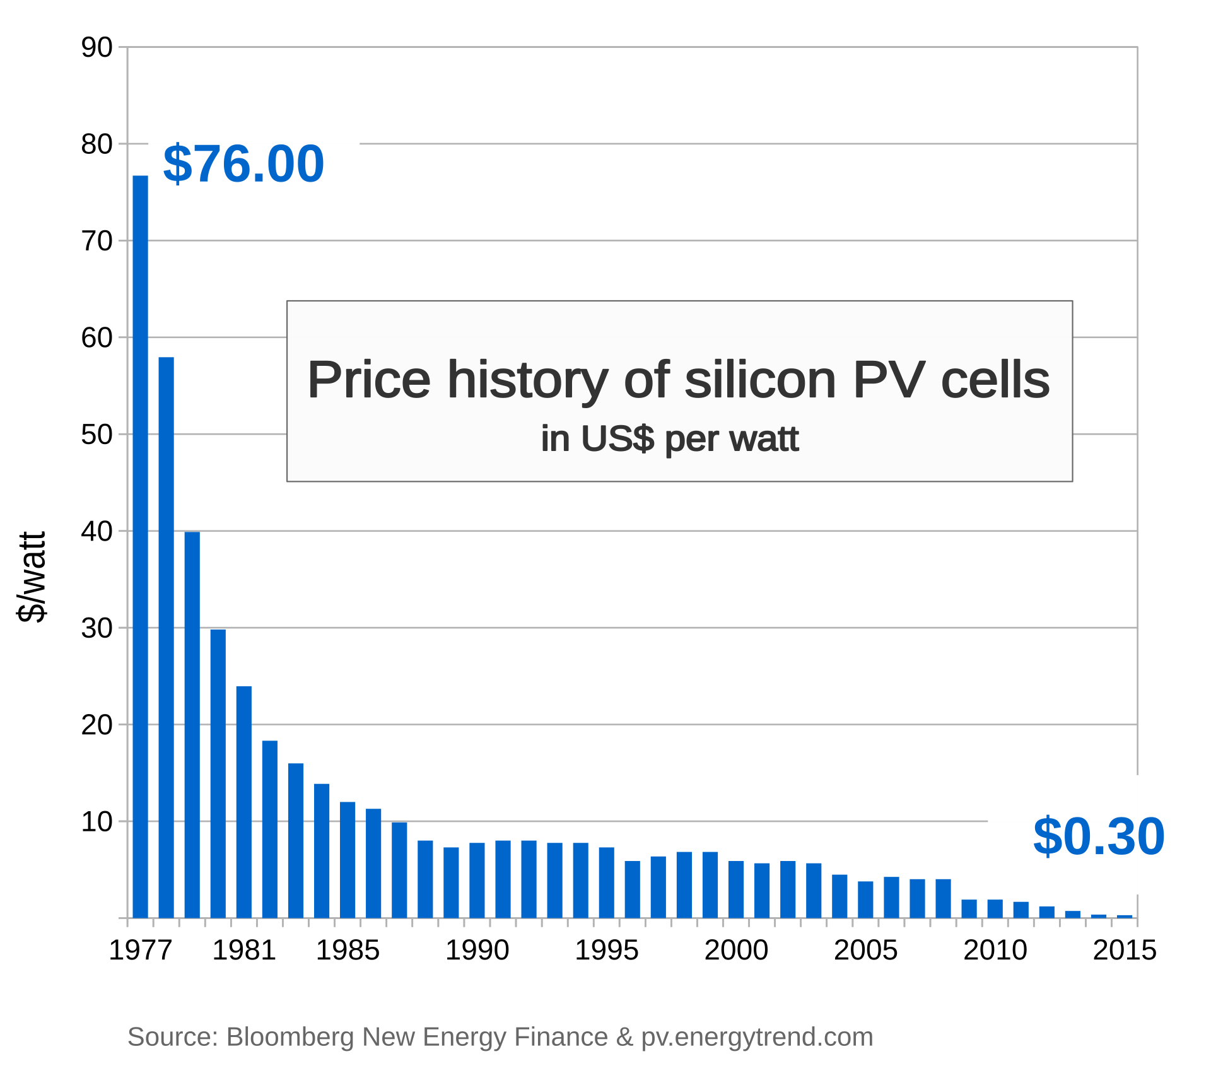
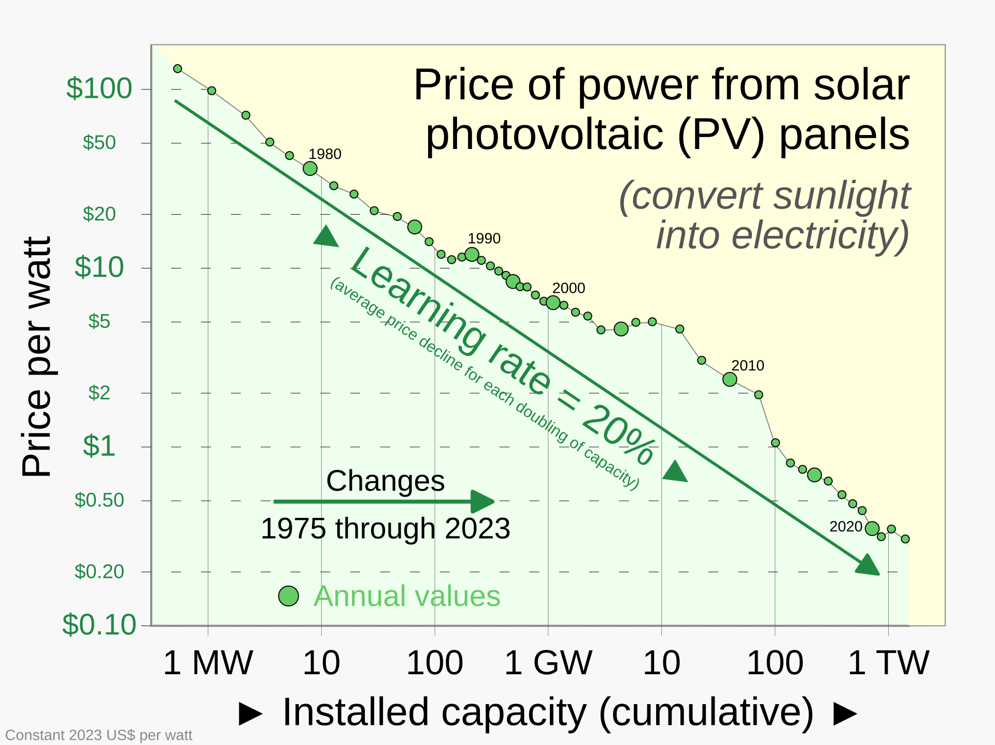
Solar Industry

Slide 4
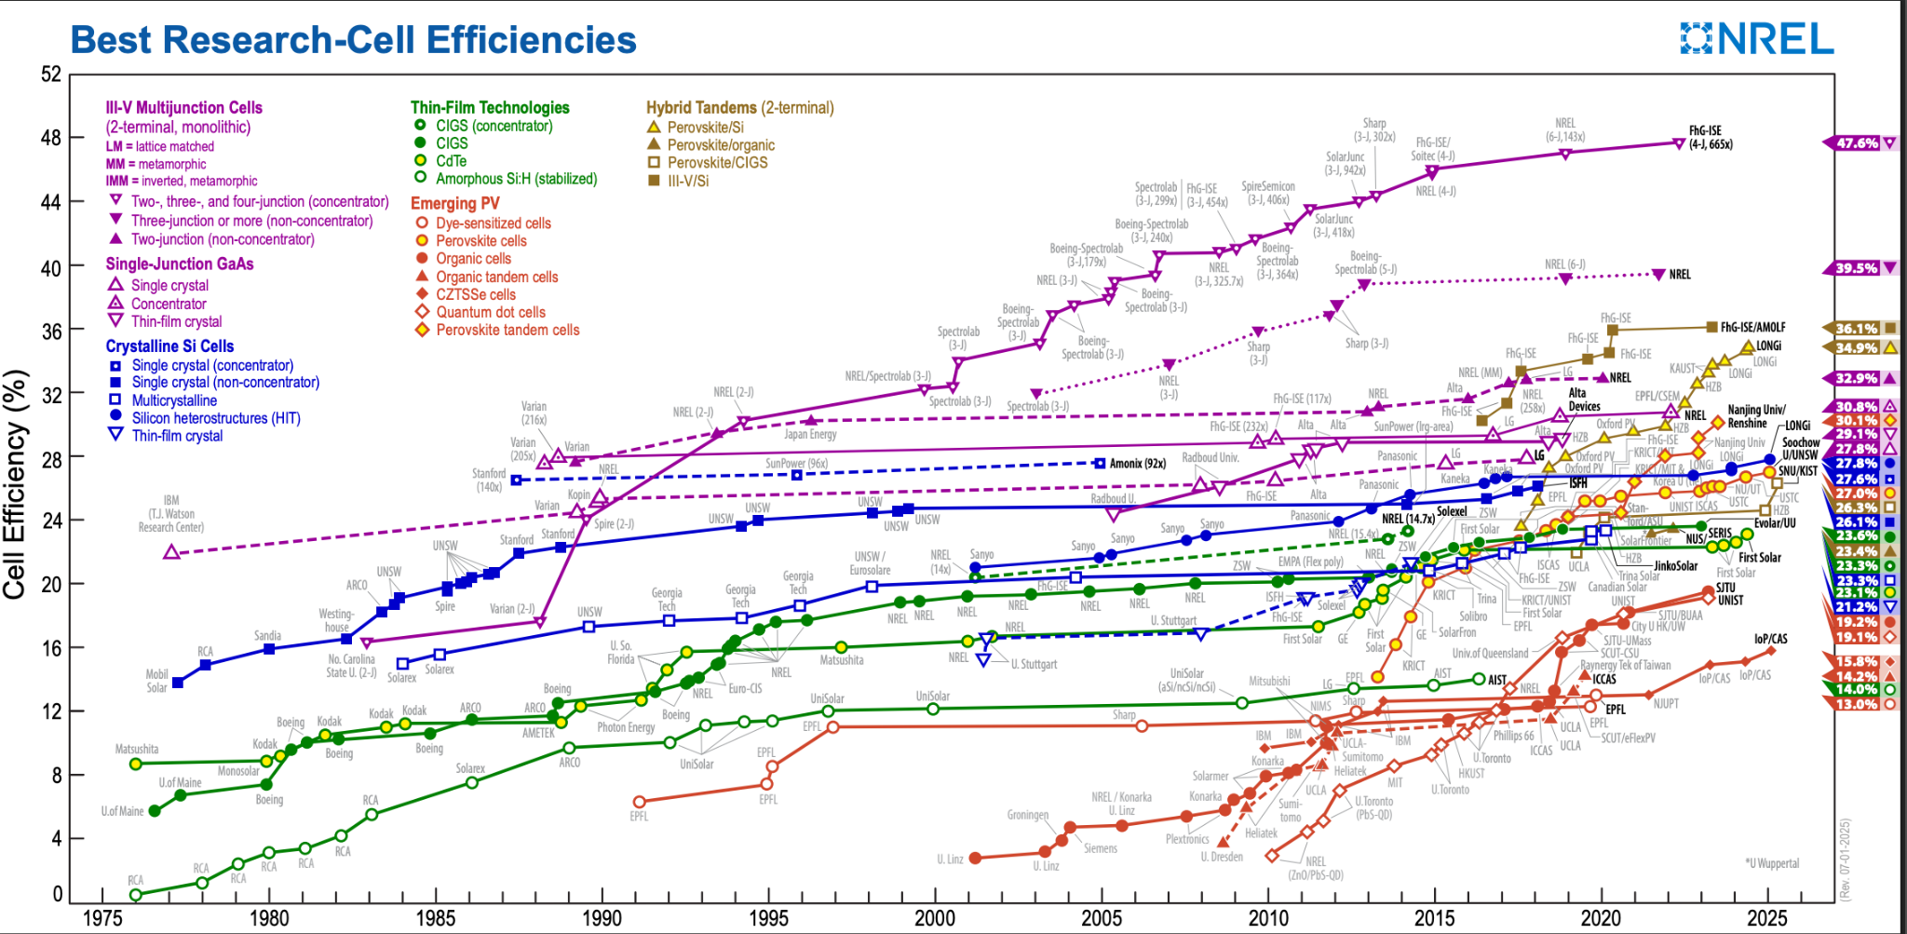

Slide 5
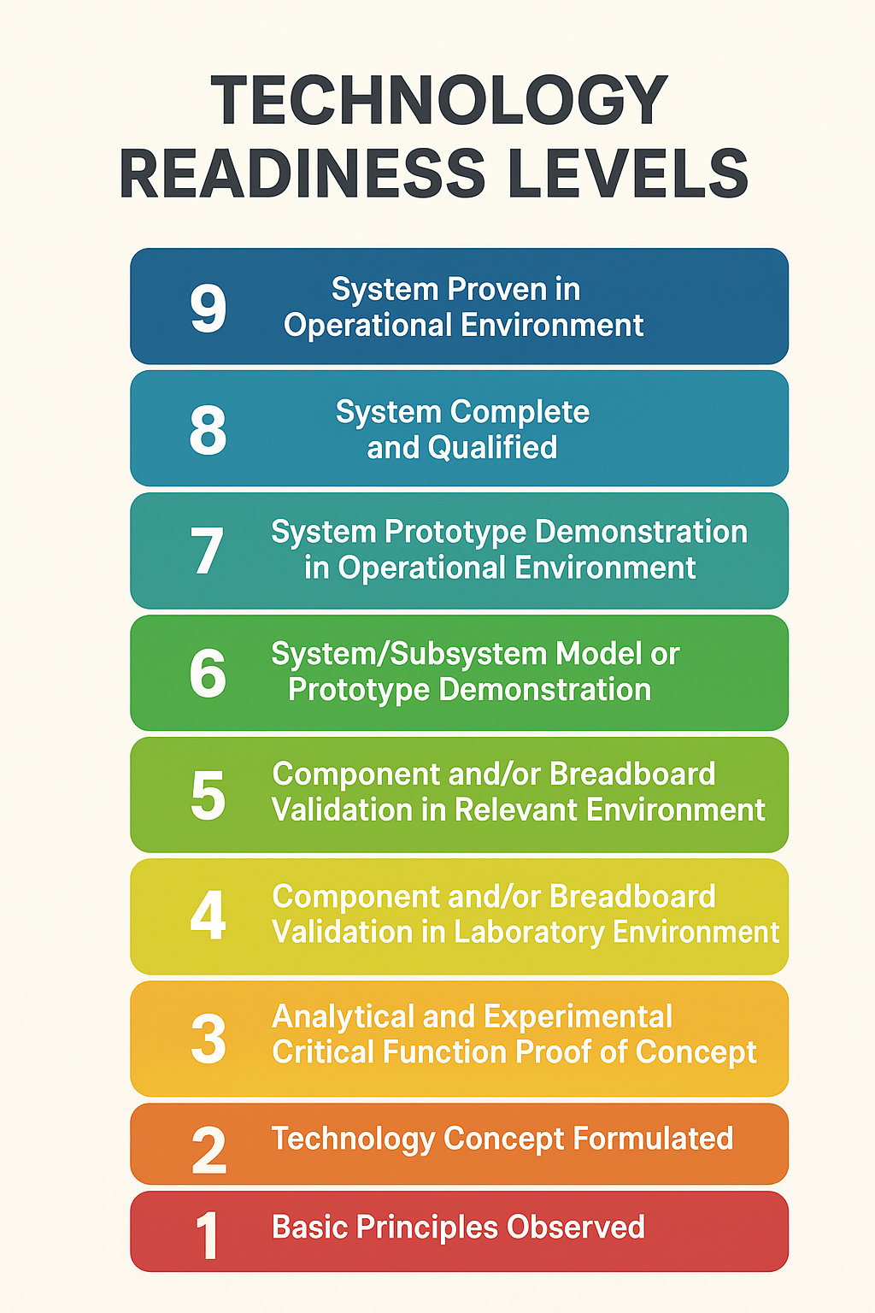
Research to Production phase

Slide 6

ML/AI Accelerates Solar Cell Development
Accelerate Discovery
Reduce R&D Costs
Break Performance Barriers
Enable Mass Production
  Models identify which lab champions can scale to factories
  Predict stability/degradation before 1000-hour tests
  Optimize for performance AND manufacturability
Accelerate Clean Energy Transition

Slide 7
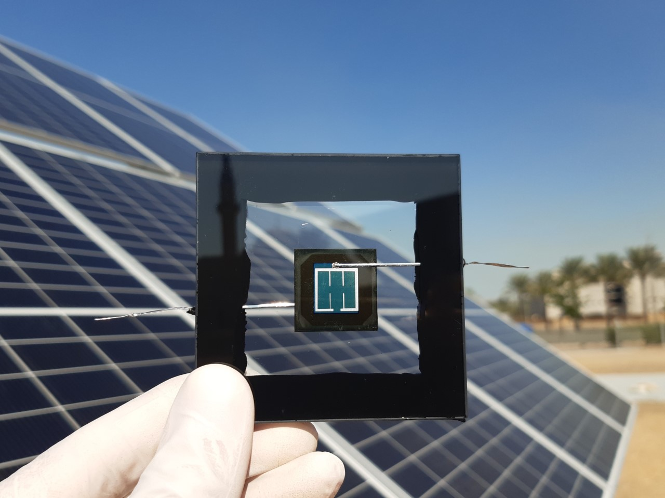
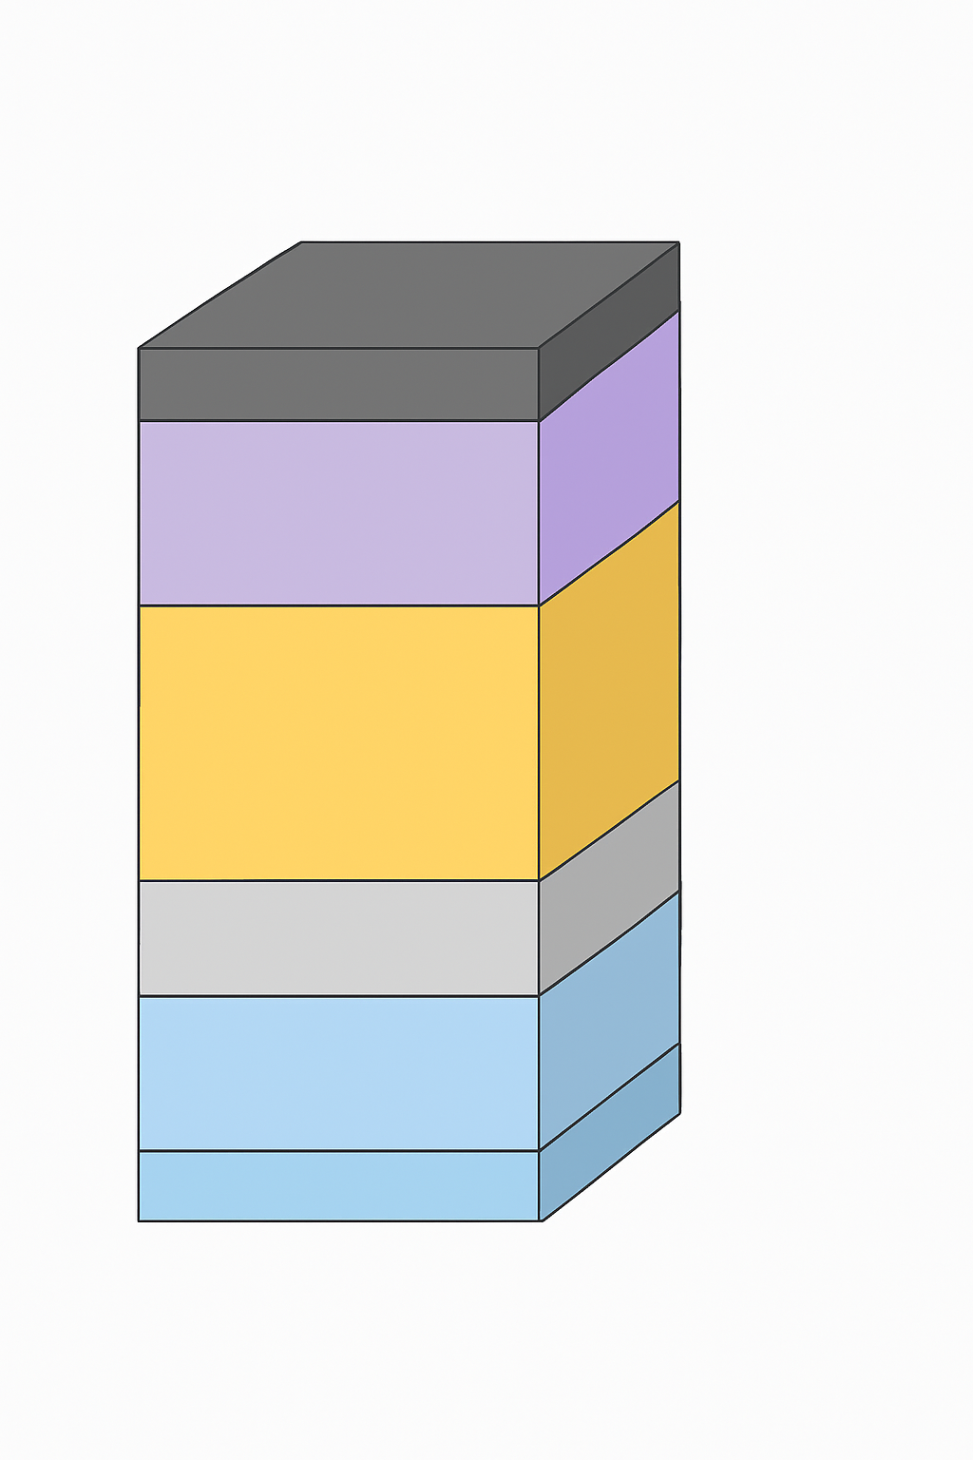
Overview of Solar Cells
Electronic device that converts light energy into electricity using photovoltaic effect
Absorber layer is the core material and is responsible for converting light into electron-hole pairs.
All the other components help in transporting these electron/hole pairs and complete the electric circuit
Metal
HTL
Absorber
ETL
TCO

Slide 8
Transparent Conductive Oxides (TCO)
  This layer, typically made of materials like fluorine-doped tin oxide (FTO) or indium tin oxide (ITO), serves as the transparent top electrode.
  It allows sunlight to pass through to the active layers while also collecting the generated electrons
Electron Transport Layer (ETL)
  The ETL is a crucial component that facilitates the extraction of electrons from the solar cell active layer and transports them to the TCO.
  Common materials for the ETL include titanium dioxide (TiO2) and tin oxide (SnO2).
Perovskite Absorber Layer
  This is the heart of the solar cell.
  This layer absorbs light from sun, creates electron-hole pairs.
Hole Transport Layer
  The HTL is responsible for extracting the positively charged "holes" left behind in the perovskite layer after the electrons are excited.
  It then transports these holes to the metal back contact.
Back Metal Contact
  This layer, typically made of gold (Au) or silver (Ag), serves as the back electrode of the solar cell. It collects the holes from the HTL, completing the electrical circuit.
Metal
HTL
Absorber
ETL
TCO

Slide 9
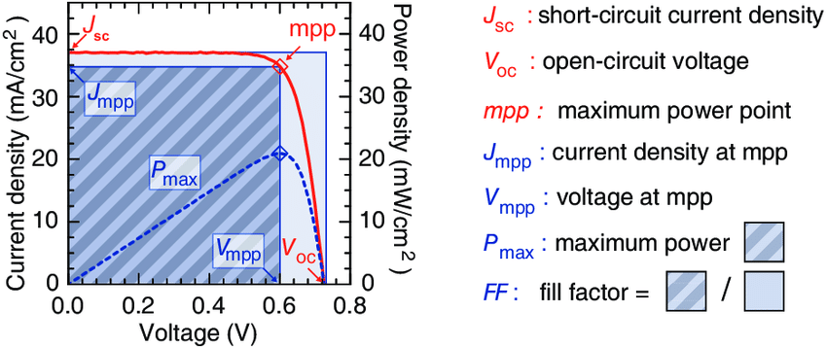
Performance Measurement (JV - Current-Voltage Curve)

Slide 10
Dataset Overview
Device Structure columns
Electron Transport Layers (ETL) columns
Perovskite Layer columns (active material for solar cell)
Hole Transport Layers (HTL) columns
Metal Contact columns
Solar cell performance metrics columns
Metal
HTL
Absorber
ETL
TCO

Slide 11
Device Structure Columns
Cell_stack_sequence: The complete layer-by-layer structure of the solar cell
Cell_architecture: Device configuration - "nip" (n-i-p) or "pin" (p-i-n) refers to the order of electron/hole transport layers
Substrate_stack_sequence: The base material layers (e.g., glass, flexible plastic)
Encapsulation: Whether the cell is sealed/protected from environment (True/False)

Slide 12
ETL Columns
ETL_stack_sequence: Materials that help electrons move to the electrode (e.g., TiO2, SnO2)
ETL_deposition_procedure: How the ETL was applied (spin coating, spray, etc.)
Metal
HTL
Absorber
ETL
TCO

Slide 13
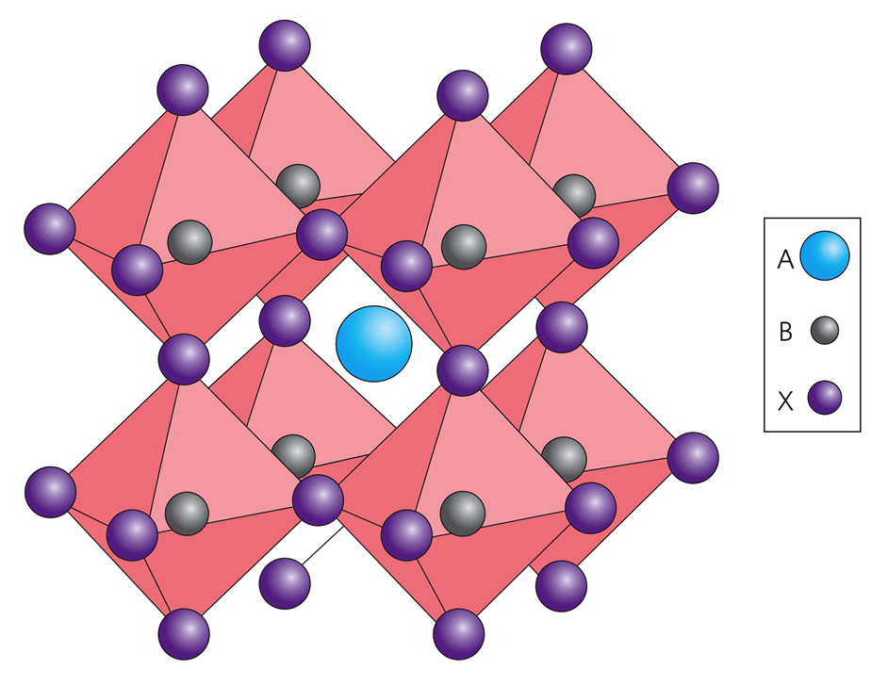
Perovskite (Solar Absorber) Columns
Perovskite_composition_[a/b/c]_ions: Chemical elements at different sites in the crystal
Perovskite_composition_short_form: Simplified chemical formula (e.g., MAPbI)
Perovskite_additives_compounds: Extra chemicals added to improve performance
Perovskite_thickness: How thick the light-absorbing layer is
Perovskite_deposition_quenching_induced_crystallisation: Rapid cooling process used (True/False)
Perovskite_deposition_thermal_annealing_temperature: Heating temperature during fabrication

Slide 14
HTL Columns
HTL_stack_sequence: Materials that help positive charges move (e.g., Spiro-MeOTAD)
HTL_deposition_procedure: How the HTL was applied
Metal
HTL
Absorber
ETL
TCO

Slide 15
Performance Metrics Columns
JV_measured: Whether electrical performance was tested (True/False)
JV_default_PCE: Power Conversion Efficiency (%) - the key performance metric
JV_default_Voc: Open-circuit voltage (V) - maximum voltage produced
JV_default_Jsc: Short-circuit current density (mA/cm²) - current generation capability
JV_default_FF: Fill Factor (%) - quality of the electrical output

Slide 16
Expectations
Performance Prediction
Can we predict PCE (Power Conversion Efficiency) from material and process parameters? This is the most fundamental challenge in the dataset.
Key Considerations:
Handle mixed data types (categorical materials, numerical temperatures, boolean flags)
Deal with chemical formulas that need parsing (e.g., "CsFAMAPbBrI" contains multiple elements)
Compare different model architectures
Feature importance analysis to identify key performance drivers
Use appropriate imputation strategies for missing performance data

Slide 17
Expectations
Anomaly Detection
Identify exceptional cells that defy expected performance patterns.
Key Considerations:
Implement different detection methods:
  Statistical: Isolation Forest, LOF, One-Class SVM
  Deep Learning: Autoencoders, VAEs
Define "anomaly" in context (outstanding performance, unusual behavior)
Investigate why these cells are anomalous

Slide 18
Expectations
Others:
Use unsupervised learning to identify families of similar perovskite compositions. Do these clusters correlate with performance? Use dimensionality reduction for visualization.
Simultaneously predict all four JV parameters (Voc, Jsc, FF, PCE). Does joint learning improve individual predictions?
Build an explainable model that can tell researchers WHY certain combinations work. Use SHAP, LIME, or attention mechanisms.
Build models that know when they're uncertain.

Slide 19
Guidelines
Explore: Explore different aspects of the data thoroughly before starting model development. Dataset overview, Exploratory findings, Data quality issues and solutions
Feature Engineering: Spend enough time here - it often matters more than model choice
Start Simple: Begin with baseline models before complex ones
Validation Strategy: Always use proper cross-validation
Interpretability: Always try to understand what your model learned
Error Analysis: Study failures as much as successes
Uncertainty: Report confidence intervals for predictions wherever appropriate
Overfitting: Use regularization and proper validation

Slide 20
Resources
KFold cross-validation: https://scikit-learn.org/stable/modules/generated/sklearn.model_selection.KFold.html
Ensemble Models: https://scikit-learn.org/stable/api/sklearn.ensemble.html
Advanced Ensemble techniques: VotingRegressors and StackingRegressors
Feature importance and explainability: https://shap-community.readthedocs.io/en/latest/index.html https://scikit-learn.org/stable/api/sklearn.inspection.html
Uncertainty Quantification or prediction intervals
Scikit-Learn Pipeline

